Slide 1

Nonprofit Sector and the difficulties with Recruitment and Retention by Puneet “P$” Kumar

Slide 2
What does “Nonprofit“ Organization mean?
A nonprofit organization (NGO), also known as a nonbusiness entity or nonprofit institution, and often referred to simply as a nonprofit, is a legal entity organized and
for a collective, public or social benefit, as opposed to an entity that operates as a business aiming to generate a profit for its owners.

Slide 3







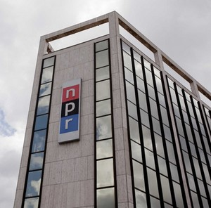



This Photo by Unknown Author is licensed under CC BY
This Photo by Unknown Author is licensed under CC BY
This Photo by Unknown Author is licensed under CC BY
This Photo by Unknown Author is licensed under CC BY-SA
This Photo by Unknown Author is licensed under CC BY
This Photo by Unknown Author is licensed under CC BY
This Photo by Unknown Author is licensed under CC BY-NC-ND
This Photo by Unknown Author is licensed under CC BY-SA-NC
This Photo by Unknown Author is licensed under CC BY-SA-NC

Slide 4
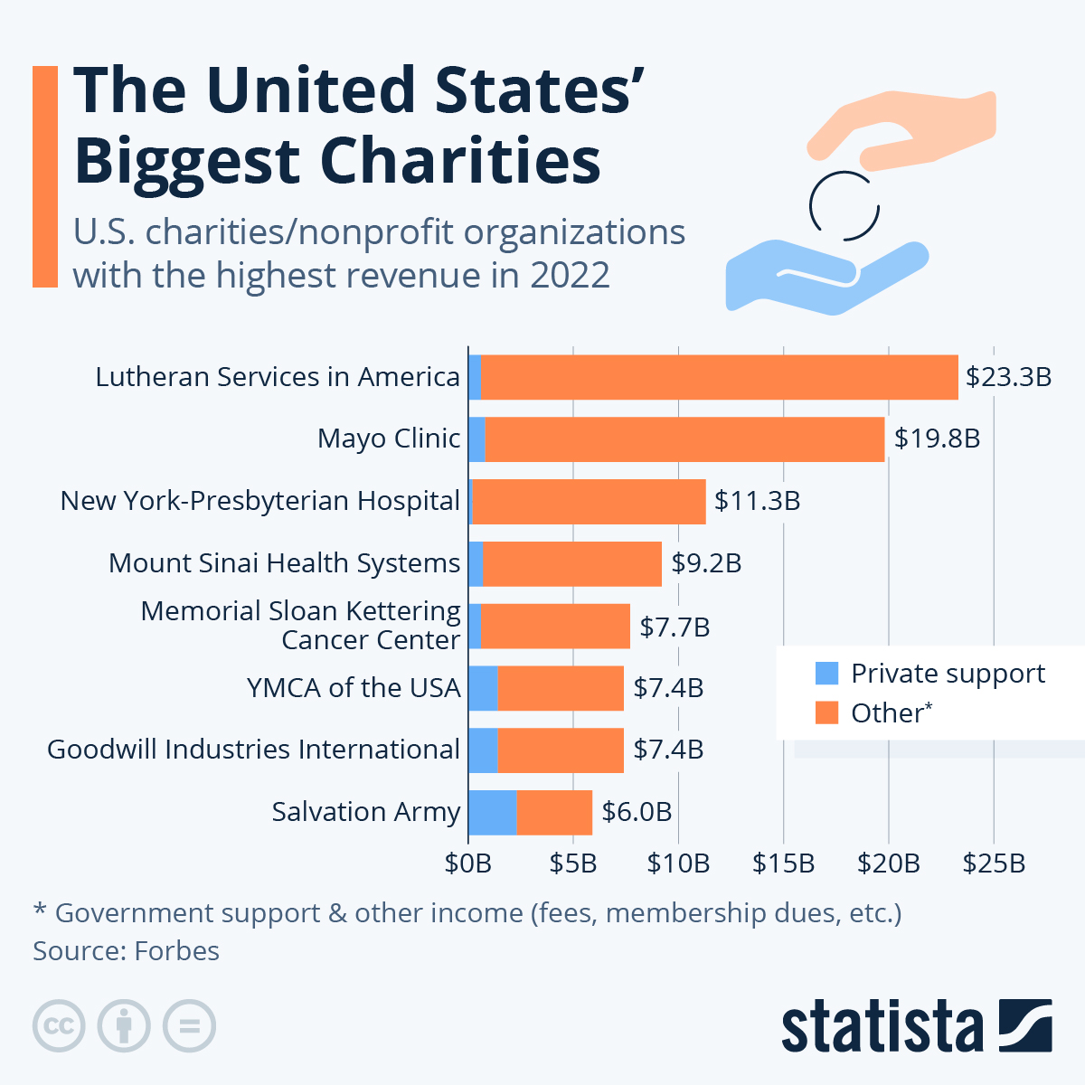
Cnfidence-building strategies

Slide 5
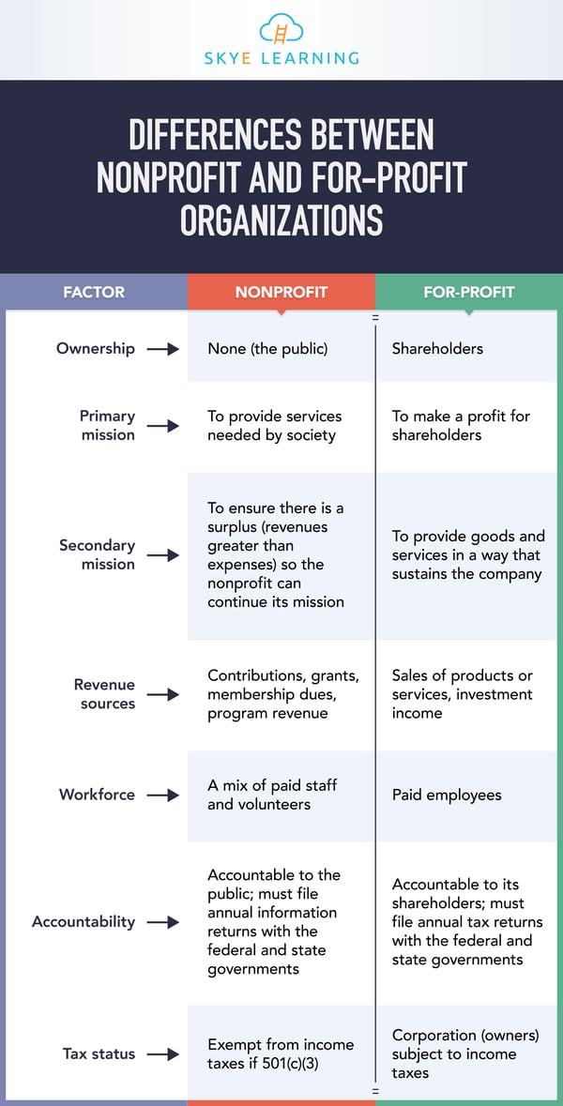


Slide 6
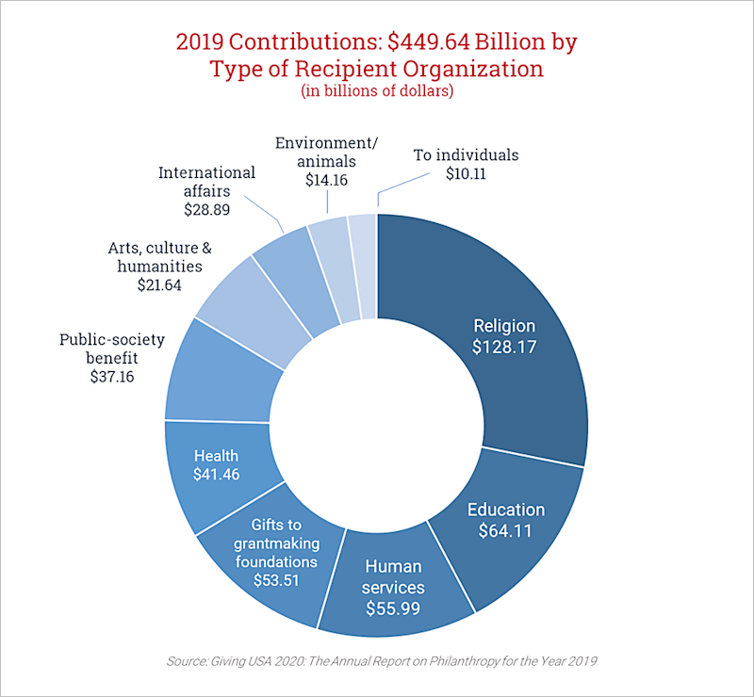

Slide 7
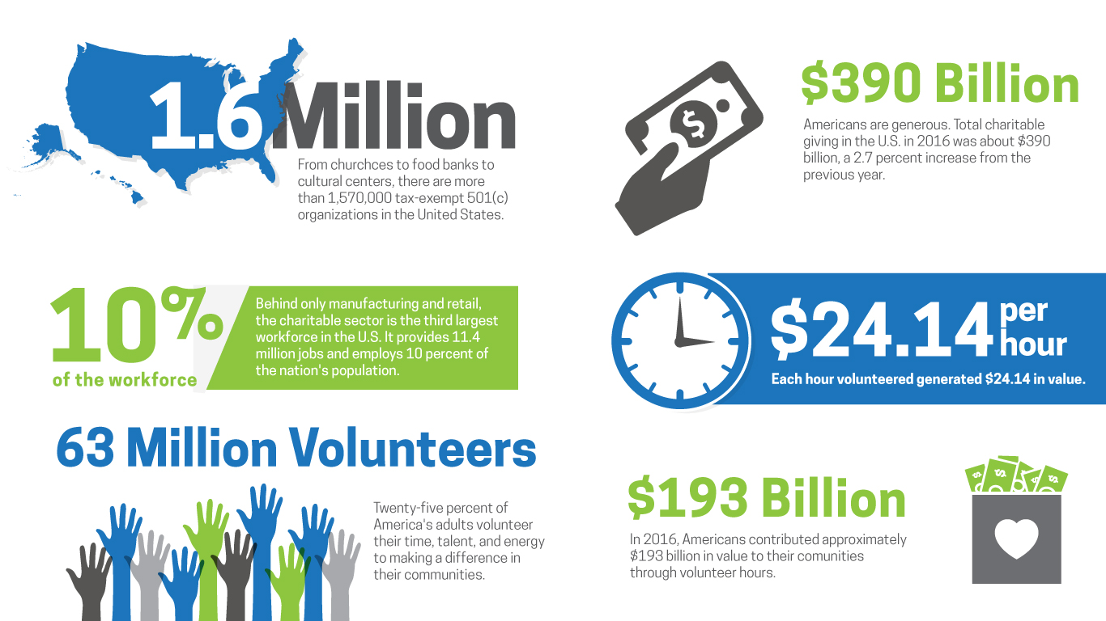
Selecting visual aids
Enhancing your presentation

Slide 8
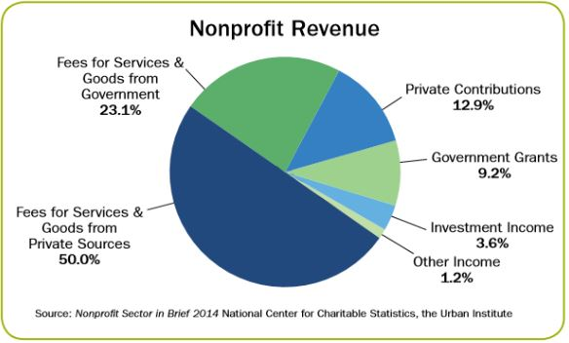

Slide 9

“I would point out that under U.S. law, charitable foundations need to pay out 5 percent of their assets every year to maintain their tax-exempt status. But the assets of the Gates Foundation Trust are mostly in stock, including investments in some of the companies that contribute to the same problems the foundation is supposed to be fighting—and stock prices are not limited to a 5-percent annual return. In one year, I’d say, entirely apart from any actual donations, the value of the Foundation’s assets rose by nearly $10.5 billion. The Foundation is making far more money than it gives away, and all that income is completely tax-free. It’s a scam, I’d say, the biggest scam in the world. It’s a clever trick used by large amounts of money to maintain their size. (Beaty).
This Photo by Unknown author is licensed under CC BY-NC.

Slide 10


Slide 11
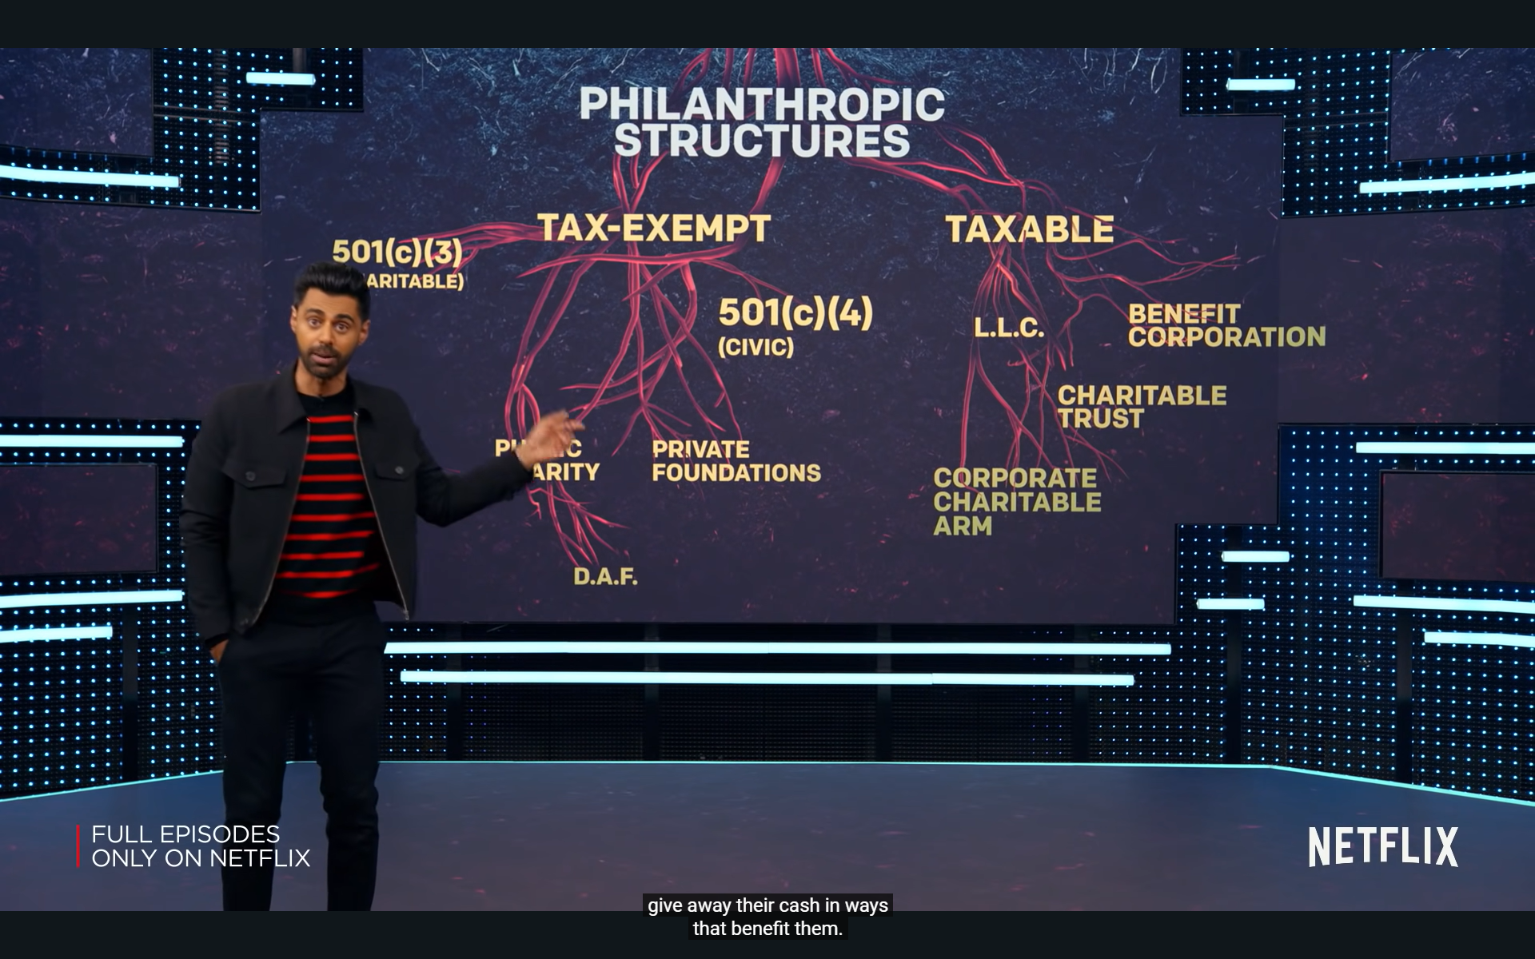

Slide 12
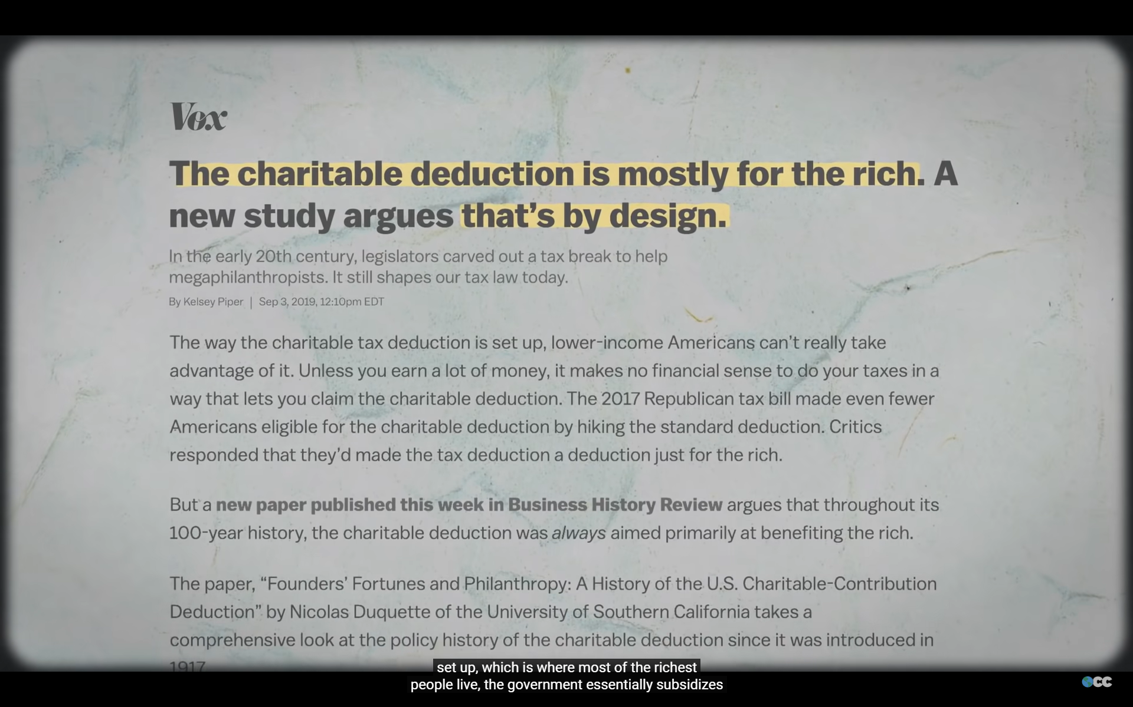
Thank you

Slide 13

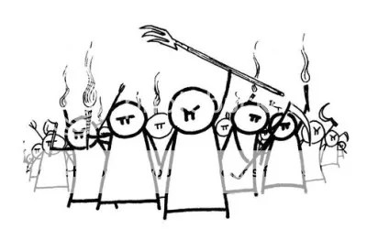
This Photo by Unknown author is licensed under CC BY-SA.

